Slide 1
CSSSKL 342: Week 5
4/28/2023
Prof. Katie Ewing

Slide 2
Today’s topics
Lab 4 review and learnings
Limits
STL library
Vectors
Lists
Sets
Maps
Iterators
Other topics: rand(), auto, cmath, switch, character and string functions

Slide 3
Exercise 1: deep/shallow copy
The copy() function, which is used by both the assignment operator and copy constructor, is doing a deep copy.
The key is here: *ip = *(other.ip);. Since this is copy the data at ip, instead of just the pointer ip itself, it is a deep copy.
void MyClass::copy(const MyClass& other)
{
i = other.i;
d = other.d;
s = other.s;
ip = new int;
*ip = *(other.ip);
}

Slide 4
Exercise 1: memory leak
When you ran valgrind on the initial code, you should’ve seen that there was a memory leak!
valgrind --leak-check=full ./a.out
==1905198== HEAP SUMMARY:
==1905198== in use at exit: 4 bytes in 1 blocks
==1905198== LEAK SUMMARY:
==1905198== definitely lost: 4 bytes in 1 blocks
==1905198== indirectly lost: 0 bytes in 0 blocks
==1905198== possibly lost: 0 bytes in 0 blocks
==1905198== still reachable: 0 bytes in 0 blocks
==1905198== suppressed: 0 bytes in 0 blocks

Slide 5
Exercise 1: memory leak
The ip data member is an int * created using new. Therefore, it must be deleted using delete
When the assignment operator is called, the left hand object is being overwritten by the right hand object. The left hand object will no longer exist, so it needs to have all its resources released
// assign m2 to m1, overwriting m1
m1 = m2;

Slide 6
Exercise 1: memory leak
MyClass& MyClass::operator=(const MyClass& rhs)
{
if (this != &rhs) {
// the memory for ‘this’ object is being leaked!
copy(rhs);
}
return *this;
}

Slide 7
Exercise 1: memory leak
MyClass& MyClass::operator=(const MyClass& rhs)
{
if (this != &rhs) {
// fixed
clear();
copy(rhs);
}
return *this;
}
Show demo w/ simplified code

Slide 8
Exercise 1: memory leak
One way to double-check that you are handling your memory correctly is to check that the pointer is null and not null at the right times
void MyClass::copy(const MyClass& other)
{
assert(ip == nullptr);
ip = new int;
*ip = *(other.ip);
}
void MyClass::clear()
{
assert(ip != nullptr);
*ip = 0;
delete ip;
ip = nullptr;
}

Slide 9
Exercise 1: pointer check
We should always check if the pointer is null before trying to dereference
Dereferencing a null pointer causes a segfault and the program will crash
What you do if the pointer is null depends on the situation. Maybe you want to initialize it, maybe you want to print a message, maybe you want an assert() or exit()
void MyClass::setIp(int newIp)
{ if (ip == nullptr) {
ip = new int;
}
*ip = newIp;
}
int MyClass::getIp() const
{
if (ip != nullptr) {
return *ip;
}
cout << “ip is null” << endl;
return -1;
}

Slide 10
Exercise 1: MySubClass
class MySubClass : public MyClass {
public:
MySubClass();
MySubClass(const MySubClass& orig);
~MySubClass(void);
MySubClass& operator=(const MySubClass& rhs);
int getSubClassData(void) const;
void setSubClassData(int);
private:
int subClassData;
};

Slide 11
Exercise 1: MySubClass
MySubClass::MySubClass() : subClassData(0), MyClass()
{
// ip in MyClass will be initialized by calling MyClass()
}
MySubClass::MySubClass(const MySubClass& orig) : MyClass(orig)
{
// MyClass(orig) will initialize parent's data
subClassData = orig.subClassData;
}

Slide 12
Exercise 1: MySubClass
MySubClass& MySubClass::operator=(const MySubClass& rhs)
{
if (this != &rhs) {
// the following call will copy parent's data
MyClass::operator=(rhs);
subClassData = rhs.subClassData;
}
return *this;
}

Slide 13
Exercise 2 & 3: Templates & header files
Templates require the definition of the template class or function to be in the same location as the implementation
This results in a blurring of the isolation between interface and implementation
Your choice on the least ugly way to solve this problem
You can put the template function definitions straight into the .h file
You can #include “File.cpp” at the bottom of the header file
You can #include “File.cpp” at the top of your driver file
If you are using #include on your .cpp files, you need to put an include guard
i.e. #ifndef FILE_C / #define FILE_C / #endl
gcc will warn you about #pragma once
Use a different global variable for your header and cpp files

Slide 14
Exercise 2: template functions
template <typename T>
void MyBubbleSort(T *data, int size) {
for (int i = 0; i<size; i++) {
for (int j = 0; j<size-1-i; j++) {
if (data[j] < data[j+1])
MySwap(data[j], data[j+1]);
}
}
}
template<typename T>
void MySwap(T &s1, T &s2) {
T t = s1;
s1 = s2;
s2 = t;
}

Slide 15
Exercise 2: sort other way
bool Square::operator>(const Square& other)
{
return theSize > other.getSize();
}
void MyBubbleSort(T *data, int size) {
for (int i = 0; i<size; i++) {
for (int j = 0; j<size-1-i; j++) {
if (data[j] > data[j+1])
MySwap(data[j], data[j+1]);
}
}
}

Slide 16
Exercise 2: template class
template <typename T>
class Square {
// definition of square
};
// function definitions need to have template keyword too
template <typename T>
void Square<T>::setSize(T newSize)
{
theSize = newSize;
}

Slide 17
Exercise 2: operator<< throws the compiler for a loop
template <typename T>
class Square {
template <typename T2>
friend std::ostream& operator<<(std::ostream&, const Square<T2>&);
Without the re-declaration of the template type, the compiler assumes this function is a non-templated function
When it reaches the definition of the function, it doesn’t know how to match it to the declared function

Slide 18
Exercise 3: fixing the file
There is a definition mismatch between the header file and the cpp file for the operator* (one has const and the other doesn't.) These need to match, either both const or both not.
The template code needs to be all in one place (it is currently split between .h and .cpp). You can fix this by moving the definitions of the template function to the header file

Slide 19
Exercise 3: iterator operator++
Increment operator always returns a type of the thing it is incrementing, in this case an iterator
The postfix operator returns the iterator from before it was incremented, the prefix operator returns the iterator after it has been incremented
The iterator that is being returned already exists before calling the increment operator, so it does not need to be allocated again (it is returned as a pointer)
iterator operator++();

Slide 20
Exercise 3: const operator*
Making the operator* method const (putting the const after the name of the function) is a good practice and consistent with how we use operator*. operator* should be faithfully returning the value of what is at the iterator, and not changing anything inside of the function.
Making the return type for operator* const (putting the const before the return type) changes how the value can be used (it can no longer be changed). This is a valid choice in some situations, what this does is essentially make the iterator read-only.
T& operator*() const;

Slide 21
What have we learned? (week 1)
Basic linux command line usage
How to SSH to another machine
How to compile a c++ program
How to run a c++ program
The main() function
The difference between pass by value and pass by reference
How to implicitly and explicitly cast types
How to take input from standard in
How to print to standard out
How to read from a file
Newline and carriage return

Slide 22
What have we learned? (week 2)
What is a pointer?
How to manipulate pointers
How to dereference a pointer and how to find the address of a variable
C++ arrays
The heap vs. the stack
How to allocate memory dynamically (new)
How to deallocate memory (delete)
How to prevent memory leaks
How to detect memory leaks
Basic testing principles
How to create a class and a struct
Conditional directives: #ifdef DEBUG

Slide 23
What have we learned? (week 3)
How the memory allocator works
Memory addressability - what is the value you get for a memory address?
Basic readability principles
Header files
Preprocessing directives: include guards
Constructors
How to initialize data members
Destructors
Function overloading
Class inheritance
Variable lifespan
Static keyword
Exceptions
Lvalues and rvalues

Slide 24
What have we learned? (week 4)
Header files best practices
How to debug compiler messages
Public / protected / private inheritance
Using this from inside a class
Using the scope :: operator
Copy constructors
Assignment operators
Deep & shallow copy
How to write template classes and template functions
Operator overload
Nested classes
Friend classes
Iterators

Slide 25
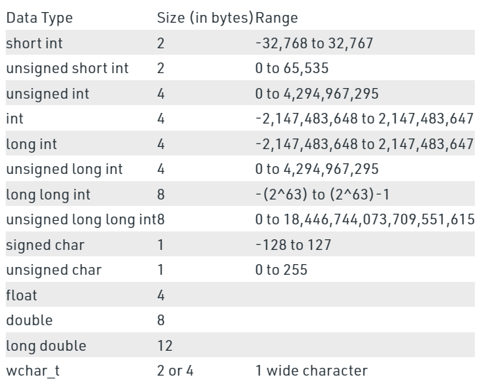
Primitive types
Integer (int)
short, long
signed, unsigned
Character (char)
signed, unsigned
Boolean (bool)
Floating point (float)
Double floating point (double)
Long
Wide character (wchar)
Source: https://www.geeksforgeeks.org/c-data-types/

Slide 26
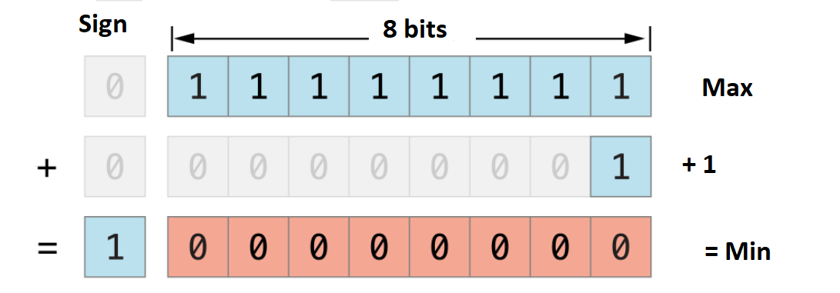
Overflow / underflow
Every primitive has a minimum and maximum value it can represent
int is often represented in 32 bits, 31 are used for data and 1 is used for sign
int (32 bit): max 2^31 - 1 = 2,147,483,647, min -(2^31) -2,147,483,648
If you go past the maximum value, it will “loop” back to the minimum value (think of an old school odometer rolling over)

Slide 27
numerical_limits<>
In library <limits>
min() - minimum value supported by type
max()- maximum value supported by type
digits10 - number of digits that are guaranteed to be accurately represented
is_signed - true if type is signed
is_integer - true if type is an integer
cout << "max of int is " << numeric_limits<int>::max() << endl;
cout << "digits for float is " << numeric_limits<float>::digits10 << endl;
https://en.cppreference.com/w/cpp/types/numeric_limits

Slide 28
Standard Template Library (STL)
We’ve learned how to create template classes and functions, now we get to use them
Containers (not a complete list!)
Sequence containers: list, vector, array, deque, forward_list
Container adaptors: queue, priority_queue, stack
Associative containers: set, unsorted_set, multiset, map, multimap, unordered_map
Iterators
Algorithms
sort, reverse, swap, sample, min_element, max_element, copy

Slide 29
Time complexity - big-O basics
As the size of the data gets larger, does the amount of computation needed increase? And by how much?
Constant time O(1)- the amount of computation does not increase based on the size of the data, for example adding an element to the top of a stack
Linear time O(N)- proportionate to the size of the data, for example reading every element of a list
Amortized constant time - the average time over many actions is constant, but it may be big or small for any specific action, for example selective resize of an array
Many complexities slower than linear - O(N^2), O(N^M), O(2^N), O(N!)

Slide 30
Vectors
Use vectors by including the vector library: #include <vector>
Vectors are lists of data of the same type
Allows efficient random access anywhere in the list
Vectors can be resized, you can add or remove elements
vector<int> a; // make an empty int vector
vector<int> b(5); // make an int vector of size 5
vector<int> c = {1,2,3}; // make an int vector with 1,2,3
vector<int> d(5, 0); // make an int vector of size 5, with 0 in every position

Slide 31
Vectors v. Arrays
Both hold lists of data that can be randomly accessed
Both hold only one data type
Arrays are a fundamental type
You don’t need a library
Arrays are backwards compatible with C, vectors are not
Vectors are a templated type in the vector library
Vectors have a lot of built-in functions that make them easier to work with
Vectors can change size (they are dynamically sized)
Vectors are Standard Template Library (STL) containers - this means that they work with many standard algorithms

Slide 32
Vector access operations
Just like arrays, you can access an array using the [] operator
Vectors also have an .at() function
Just like .at() and [] for strings, .at() does bound checking while [] does not
Generally, this makes .at() a better choice!
vector<int> v = {8, 10, 12, 14};
cout << v.at(0); // print 8
cout << v[0]; // print 8
cout << v.at(10); // out of bounds ERROR
cout << v[10]; // behaviour undefined

Slide 33
Vector functions - size() and empty()
int vector.size() - gets the number of elements in the vector
bool vector.empty() - returns true if the vector has no elements, false if there is at least one element
vector<int> e;
size = e.size(); // size is 0
isEmpty = e.empty(); // true
vector<int> v = {1,2,3,4,5};
int size = v.size(); // size is 5
bool isEmpty = v.empty(); // false

Slide 34
Vector push_back(), pop_back()
Vectors are designed to be efficient (amortized constant time) when adding or accessing elements at the end of the vector
vector.push_back(T elem) will add the element elem to the end
vector.back() will return the last element of the vector
vector.pop_back() will remove the last element of the vector
vector<int> v = {1, 2, 3, 4, 5};
v.push_back(6); // add 6 to the end of the vector
v.push_back(7); // {1, 2, 3, 4, 5, 6, 7}
int lastInt = v.back();
cout << lastInt; // lastInt is 7
v.pop_back(); // v is {1, 2, 3, 4, 5, 6}

Slide 35
Nested (multi-dimensional) vectors
A vector can hold a list of any other data type, including other vectors
A two-dimensional vector, which is a vector of vectors, can be used to hold a grid of data
vector<vector<int>> square(3, vector<int>(3, 0));
for (int i = 0; i < 3; i++){
for (int j = 0; j < 3; j++){
cout << square.at(i).at(j) << " ";
}
cout << endl;
}

Slide 36
List<>
In library <list>
A sequence container
Implemented as a doubly-linked list
Allows efficient (constant time) insert and erase anywhere in the list
Supports bidirectional iterators (can traverse backwards and forwards)
Less efficient when looking for specific items inside the list, you have to traverse the full list
No random access

Slide 37
Creating lists
list<int> a; // empty int list
list<int> b = list<int>(10); // int list of size 10
list<int> c{20,22,25}; // int list with elements
list<int> d = list<int>{20,22,25}; // same as previous
list<string> e = list<string>{"hi","bye"}; // list with strings

Slide 38
Using lists
list<int> a;
list<int> c{20,22,25};
a.front(); // get first element
a.back(); // get last element
a.push_back(5); // adds 5 to back of list -> {5}
a.push_front(7); // adds 7 to front of list -> {7,5}
a.pop_front(); // removes the front element of the list -> {5}
a.pop_back(); // removes the back element of the list -> {}
//a.pop_back(); // removing too many items! Run-time error
c.insert(++c.begin(), 34); // adds 34 as the second element of the list
//int g = d[2]; // ERROR, no random access
// use iterators to traverse the list
for (list<int>::iterator it = c.begin(); it != c.end(); it++){
cout << *it << endl;
}

Slide 39
List methods
size() - gets the number of elements in the list
sort() - sorts the list
reverse() - reverses the order of the list
empty() - returns a bool, whether the list is empty or not
unique() - removes all duplicate elements from the list
insert() - inserts an element at the list at the position indicated by the iterator
erase() - removes an element from the list at the position indicated by the iterator
remove() - removes all elements from the list that are equal to the given element
remove_if() - remove all elements that satisfy a given condition
splice() - transfer a range of elements from one list to another

Slide 40
Pair
Pair is a templatized class that associates two objects together, which may be different types
Pair is in the <utility> library
The two objects in the pair can be obtained with the first and second members
pair<string, int> p1 = {"hello", 5};
cout << "Pair first: " << p1.first << endl;
cout << "Pair second: " << p1.second << endl;

Slide 41
Sets
Sets are defined in the <set> library
A set is an associative container, where elements are identified by their key instead of their order
Each element must be unique and the elements are held in sorted order
Sets support insert(), erase() and find() in log(N) time
Sets have iterators to obtain the values from the set
set<int> s = {6, 7, 2, 10, 3};

Slide 42
Set insert()
The insert() function can be used to insert a single element
insert() will add the element if it is not already in the set, if it is already present it will do nothing
insert() returns a pair<set<T>::iterator, bool> ( a Pair with a set iterator and a bool)
The set iterator points to the newly inserted element, or the existing element if an insertion was not done
The bool is true if a element was inserted, false if no action was taken
set<int> s = {6, 7, 2, 10, 3};
s.insert(15);

Slide 43
Set find() and count()
find() takes the value of an element, and returns an iterator to the element in the set. If the element does not appear in the set, an iterator equal to set.end() is returned
count() takes the value of an element, and returns 1 if the element is in the set and 0 if it is not
set<int>::iterator find_it = s.find(7);
if (find_it != s.end()) {
cout << "Value at iterator: " << *find_it << endl;
} else {
cout << "Value wasn't found" <<endl;
}
int count = s.count(70);
cout << ((count == 1) ? "Value found" : "Not found") << endl;

Slide 44
Set erase()
erase() removes elements from the set
There are several versions of erase()
erase(T value), with the value you want to remove. Function will return an int, with the number of elements removed (either 0 or 1)
erase(set<T>::iterator pos), with an iterator to the position of the element you want to remove
erase(set<T>::iterator begin, set<T>::iterator end),or two iterators, to indicate the beginning and end of a range to be erased
s.erase(7); // remove 7
PrintSet(s);
s.erase(s.begin()); // remove first element
PrintSet(s);

Slide 45
map<,>
In the <map> library
An associative container, key/value pairs
Key and value do not need to be the same type
(Typically) implemented as a binary search tree
Efficient (constant time) insertion of pairs
Allows efficient (constant time) finding of values by key
Supports bidirectional iterators

Slide 46
Using maps
map<string, string> m1;
m1.insert(pair<string, string>("Washington", "Olympia"));
m1.insert(pair<string, string>("Colorado", "Denver"));
m1.insert(pair<string, string>("Oregon", "Salem"));
cout << "The Capital of Washington is: " << m1["Washington"] << endl;
map<string, int> m2{{"Washington", 1889}, {"Colorado", 1876}};
cout << "The year Washington became a state is: " << m2["Washington"] << endl;

Slide 47
Maps - insert(), erase(), find(), count()
insert() - insert a key value pair. If the key already exists, do nothing. Returns a pair with an iterator to the element and bool indicating if an element was added
erase() - remove a key value pair. Can take a key, an iterator, or a start and end iterator
find() takes the a key, and returns an iterator to the element in the map. If the key does not appear in the map, an iterator equal to map.end() is returned
count() takes a key, and returns 1 if the key is in the map and 0 if it is not

Slide 48
unordered_map, unordered_set
Ordered maps and sets are implemented using binary search trees, and do all the main functions in log(N) time
You can also create unordered versions of these objects, which are called unordered_map and unordered_set. They are in the <unordered_map> and <unordered_set> libraries, respectively.
The unordered objects use hashing to find keys in amortized O(1) time. Ordered maps/sets are helpful if iterating over the set in order is part of your workflow. If your workflow is very lookup heavy, the unordered versions are probably better.

Slide 49
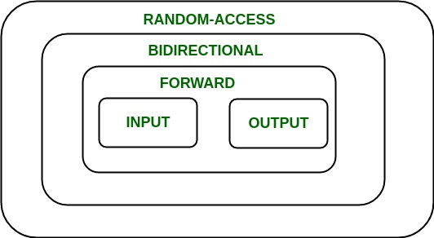
Types of Iterators
Input/output are the most basic iterator
Single pass of the range
Output to assign to the range, input to get the value of the range
Forward iterators can only move forward but can do input or output
Bidirectional iterators can also move backwards through the range
Random access iterators can access the element at location X, e.g. array[X] or *(array + X)

Slide 50
Using iterators
At minimum, an iterator must implement begin(), end() and ++
MyType v = {1, 2, 3}; // MyType is something that can be iterated
MyType::iterator i;
// Accessing the elements using iterators
for (i = v.begin(); i != v.end(); ++i)
{
// do stuff with the element at i
}

Slide 51
Using iterators with STL containers
Many built-in types in the Standard Template Library utilize iterators
What kind of iterator is used depends on the type
vector<int> v = { 1, 2, 3 };
// Declaring an iterator
vector<int>::iterator i;
// Accessing the elements using iterators
for (i = v.begin(); i != v.end(); ++i)
{
cout << *i << " ";
}

Slide 52
sort()
In the <algorithm> library
Sort any container that implements iterator and object inside of iterator that implements <
Pass a different comparison functor or function pointer to change how the elements are sorted
Uses a combination of quick sort, insertion sort and heap sort
vector<int> v;
list<int> l;
sort(v.begin(), v.end());
sort(l.begin(), l.end());
sort(l.begin(), l.end(), greaterThan);

Slide 53
sort() comparison functions
If a third argument is omitted, the < operator will be used, sorting objects from smallest to largest
A comparison function may be provided which gives the sorting algorithm a different method to determine which of two objects go first
bool greaterThan(int num1, int num2){
return num1 > num2;
}
vector<int> v = {7, -15, 21, 4, 10, -32};
sort(v.begin(), v.end(), greaterThan);

Slide 54
cmath library
cmath is a library that contains many useful math functions - use #include <cmath> to import the library
Useful functions
double pow(double base, double exponent) - gives you base to the power of exponent
double sqrt(double x) - gives you the square root of x
double round(double x) - gives you the nearest integer
double ceil(double x) - gives you the next integer, rounded up
double floor(double x) - gives you the next integer, rounded down
Library reference: https://cplusplus.com/reference/cmath/

Slide 55
Bitwise operators
In addition to logical operators, there are also bitwise operators, where the operator is applied to each bit one by one
Bitwise operators operate on the binary representation of numbers
Bitwise operators use operator syntax that is different from logical operators- AND (&), OR (|) and NOT (~). There is also a bitwise XOR (^)
186 | 10111010 | 1 | 0 | 1 | 1 | 1 | 0 | 1 | 0
& | & | 1 & 0 | 0 & 1 | 1 & 1 | 1 & 1 | 1 & 0 | 0 & 0 | 1 & 1 | 0 & 1
115 | 01110011 | 0 | 1 | 1 | 1 | 0 | 0 | 1 | 1
50 | 00110010 | 0 | 0 | 1 | 1 | 0 | 0 | 1 | 0

Slide 56
switch
int day = 3;
switch (day){
case 1:
cout << "Monday" << endl;
break;
case 2:
cout << "Tuesday" << endl;
break;
case 3:
cout << "Wednesday" << endl;
break;
case 4:
cout << "Thursday" << endl;
break;
}
}
A switch statement can switch on int, char, or enum values
A switch statement finds the case that matches the switch expression, and runs the code block starting from that case
When ‘break’ is hit, the switch statement completes. Otherwise, it runs from the case to the end of the switch block

Slide 57
rand()
rand() generates a pseudo-random number between 0 and RAND_MAX
rand() uses a seed - you can set the seed using srand(int seed)
This means that if you use the same seed repeatedly, you will get the same “random” numbers
If you do not set a seed, a seed of ‘1’ will be used
To pick a seed that will change every time you run a program, it is common to use srand(time(NULL));
#include <time.h> to use time()
You can use % to get a number in a range, i.e. rand() % 100 will get you a number between 0-99

Slide 58
auto
The ‘auto’ keyword was introduced in C++11 (in 2011)
‘auto’ allows you to omit the variable type in a declaration
‘auto’ should only be used when the type is clear from context
using auto for container iterators is often considered good style, since the iterator declaration is so long
int myIntA= 4;
auto myIntB= myIntA; // myIntB is type int
for (auto i = v.begin(); i != v.end(); ++i)
{
cout << *i << " ";
}

Slide 59
Character functions
The cctype library (#include <cctype>) has lots of functions to work with characters.
In this library, functions return an int instead of a bool type - 0 if it is ‘false’, non-0 if it is ‘true’
This is because these is a C-style library, and C does not have a boolean fundamental type
You can use type casting to turn the result into a bool instead - since 0 converts to false, and non-0 converts to true, it will work as you expect

Slide 60
Character functions, cont’d
int isalpha(char c) - Returns true if the character is a letter
int isdigit(char c) - Returns true if the character is a single digit
int isspace(char c) - Returns true if the character is a whitespace character (e.g. space or newline)
int isupper(char c) - Returns true if the character is an uppercase letter
int islower(char c) - Returns true if the character is a lowercase letter
int toupper(char c) - Returns the uppercase version of the character
int tolower(char c) - Returns the lowercase version of the character

Slide 61
Strings: String operations
string.append(string s) - adds the string s to the end of the caller string
string.insert(int pos, string s) - at the index pos, the string s is inserted into the caller string
string string.substr(int pos, int len) - creates a new string from the caller string, copying the substring from position pos, going for len characters
If you pass len as -1, it will go to the end of string
int string.find(char c)- finds the first instance of character ‘c’ in the string and returns the index position of the character. If the character is not present, a number greater than the last index is returned.
More: https://cplusplus.com/reference/string/string/

Slide 62
String operations
string h = "hello";
cout << h << endl; // “hello”
h.append("goodbye");
cout << h << endl; // “hellogoodbye”
h.insert(5, " ");
cout << h << endl; // “hello goodbye”
int oLoc = h.find('o');
cout << oLoc << endl; // oLoc is 4
string s1 = h.substr(oLoc, 3); // “o g”
cout << s1<< endl;
string s2 = h.substr(oLoc, -1); // “o goodbye”
cout << s2 << endl;

Slide 63
Work on lab 5!

